Slide 1
Homelessness and Hunger in New Jersey. What can United Methodist Church of Greater New Jersey do?

Slide 2
Homeless/Hunger in New Jersey
The governor of New Jersey, Phil Murphy, on May 9, 2019 recently singed a legislation to fight hunger in the state.
The towns with high concentration of homeless people are typically saddled with demographics that are below poverty line and struggling to their day to day living.
According to an NPR report, approximately 85% of the food that isn’t used in a typical American restaurant is thrown out

Slide 3
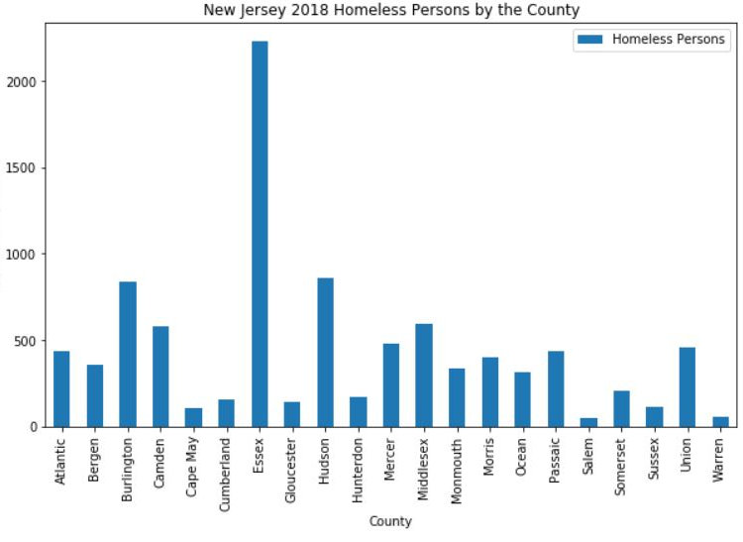
The New Jersey state wide report for homeless persons is scraped from : https://cdn.monarchhousing.org/wp-content/uploads/njcounts18/2018PITReportStatewide.pdf. And it shows that there 9303 homeless persons in New Jersey, with Essex County leading the way.

Slide 4
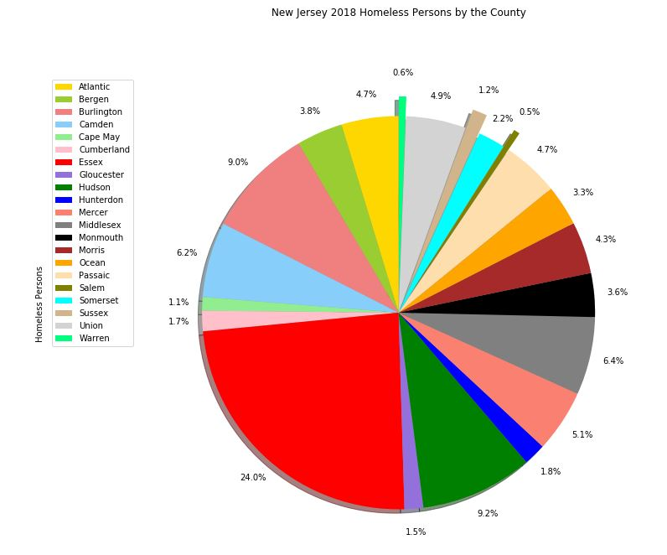
Essex County homeless accounts to 24% of the statewide count.

Slide 5
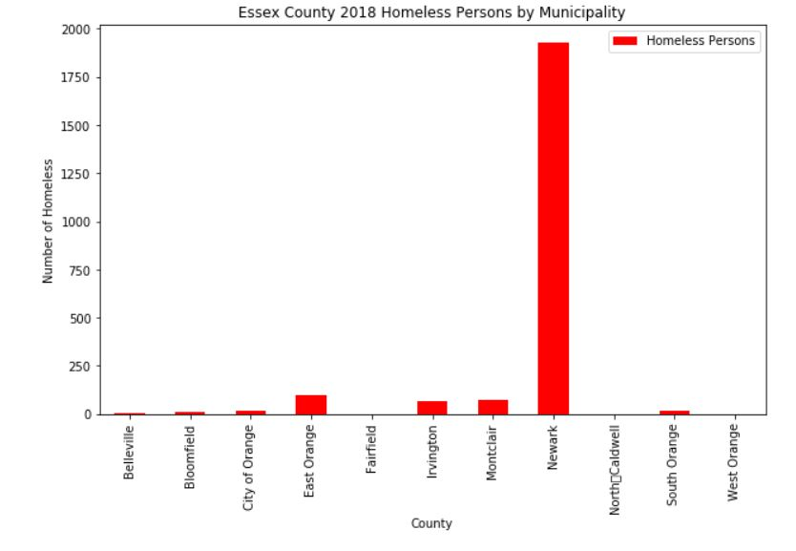
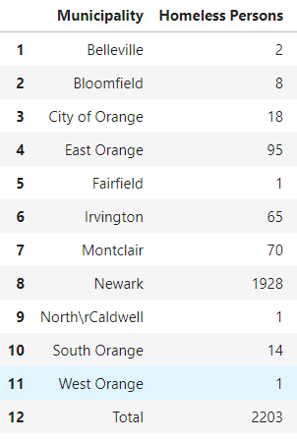
The Essex County wide report for homeless persons is scraped from : https://cdn.monarchhousing.org/wp-content/uploads/njcounts18/2018PITReportEssex.pdf. This report lists the homeless counts for each municipality in Essex Cunty. Not surprisingly it shows that the town of NEWARK has the most homeless persons with almost 2000 persons.

Slide 6
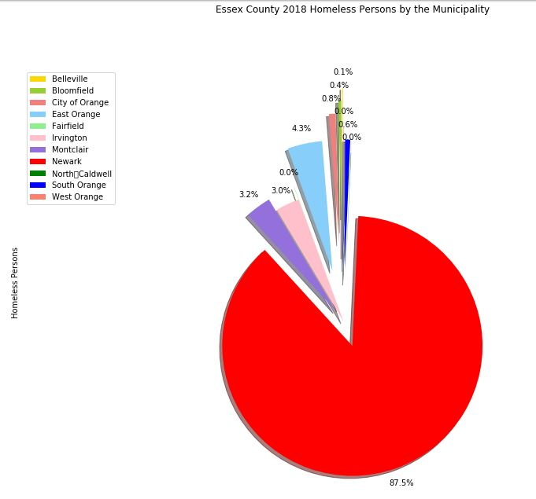
This accounts for 87.5% of the total Essex County count for homeless persons.

Slide 7
What can the UMCGNJ do?
The United Methodist Church of Greater New Jersey can charge their churches in Newark to establish Food Bank(s).
The UMCGNJ Newark churches will source out their food supply from food venues in within their proximities.

Slide 8
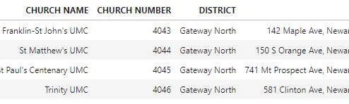
The UMCGNJ divided their presence in New Jersey into nine districts, the website list all the UMCGNJ churches the town and district where they belong. This data can be downloaded from their website, https://www.gnjumc.org/districts/. Scrapping the file shows that there are four churches in Newark.

Slide 9
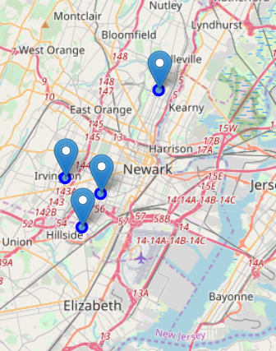
The map shows that the four UMCGNJ churches are spread out across Newark. Hence, they are strategically positioned as food banks stations.

Slide 10
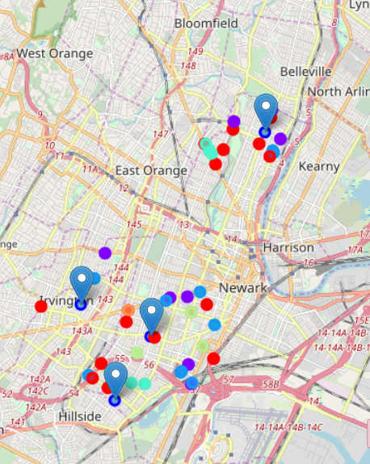
There are 51 venues that cater to food services around the neighborhoods of the churches. These venues can used as source for food supply for the proposed food banks.

Slide 11
To effective manage logistics required to collect, package, store, distribute the different types of food they collect. Different food types require different approach on logistics.
The food service venues need to be categorized (clustered) according to the food types they cater to.
Using k means clustering algorithm, its recommended that the venues be clustered into 5 venue categories :
Cluster 0 : Various Restaurants/BBQ Joints
Cluster 1 : Pizza Place
Cluster 2 : Coffee Shops
Cluster 3: Fast Food Places
Cluster 4: Deli

Slide 12
The list of venues clustered together :
No | CLUSTER | NAME | ADDRESS | CITY | CATEGORY | LATITUDE | LONGITUDE | CHURCH NAME
1 | 0 | NA"JAYYAH | Newark, NJ | Newark | American Restaurant | 40.708821 | -74.220234 | Trinity UMC
2 | 0 | Kings Restaurant | 557 Clinton Ave | Newark | Restaurant | 40.722291 | -74.203753 | Trinity UMC
3 | 0 | Leo's Café & El Guame Restaurant | 598 Broadway | Newark | Spanish Restaurant | 40.770961 | -74.162746 | St Pauls Centenary UMC
4 | 0 | Golden Krust Caribbean Restaurant | 467 Lyons Ave. | Newark | Caribbean Restaurant | 40.715278 | -74.222608 | Trinity UMC
5 | 0 | Stephanie's BBQ IV | 687 N 6th St (at Davenport Ave.) | Newark | BBQ Joint | 40.77265 | -74.179385 | St Pauls Centenary UMC
6 | 0 | Luigi's Restaurant | 561 Bloomfield Ave | Newark | Italian Restaurant | 40.774202 | -74.185984 | St Pauls Centenary UMC
7 | 0 | Bloomfield Avenue B.B.Q. | 391 Bloomfield Ave | Newark | Brazilian Restaurant | 40.768823 | -74.182088 | St Pauls Centenary UMC
8 | 0 | Vonda's Kitchen | 183 W Kinney St | Newark | American Restaurant | 40.73122 | -74.185046 | Trinity UMC
9 | 0 | Taino's Kitchen | 849 Mount Prospect Ave | Newark | Spanish Restaurant | 40.781322 | -74.162537 | St Pauls Centenary UMC
10 | 0 | Omar's Café | 646 Mount Prospect Ave | Newark | Cuban Restaurant | 40.774208 | -74.166594 | St Pauls Centenary UMC
11 | 0 | D & J Country Cooking | 363 Madison Ave (18th Street) | Newark | Comfort Food Restaurant | 40.726534 | -74.213604 | St Matthews UMC
12 | 0 | Spanish Manor Restaurant | 246 Heller Pkwy | Newark | Paella Restaurant | 40.778239 | -74.175929 | St Pauls Centenary UMC
13 | 0 | Qdoba Mexican Grill | 10 Toler Pl (Space A6G - Terminal A) | Newark | Mexican Restaurant | 40.716644 | -74.18291 | Trinity UMC
14 | 0 | Panda garden | 505 Irvington Ave | Newark | Chinese Restaurant | 40.730549 | -74.243854 | St Matthews UMC
15 | 0 | Golden Krust Caribbean Restaurant | 467 Lyons Ave. | Newark | Caribbean Restaurant | 40.715278 | -74.222608 | Franklin-St Johns UMC
16 | 0 | Amin's Fongyip Chinese Muslim | 430 Chancellor Ave | Newark | Chinese Restaurant | 40.711385 | -74.225683 | Franklin-St Johns UMC
17 | 1 | Dunkin' | 311 Springfield Ave, #313 (at Hunterdon St) | Newark | Coffee Shop | 40.733159 | -74.192187 | Trinity UMC
18 | 1 | Dunkin' | 226 Elizabeth Ave #232 | Newark | Coffee Shop | 40.715065 | -74.191777 | Trinity UMC
19 | 1 | Nubian Family Flavor | 410 Springfield Ave | Newark | Coffee Shop | 40.732864 | -74.198359 | Trinity UMC
20 | 1 | Dunkin' | 257 Lyons Ave #259 | Newark | Coffee Shop | 40.71137 | -74.215736 | Franklin-St Johns UMC
21 | 1 | Dunkin' | 880 Mount Prospect Ave (Montclair Ave) | Newark | Coffee Shop | 40.783456 | -74.162132 | St Pauls Centenary UMC
22 | 1 | Dunkin' | 802 S Orange Ave | Newark | Coffee Shop | 40.744844 | -74.221061 | St Matthews UMC
23 | 1 | Dunkin' | 895 Franklin Ave | Newark | Coffee Shop | 40.780222 | -74.175445 | St Pauls Centenary UMC
24 | 1 | Dunkin' | 10 Toler Pl | Newark | Coffee Shop | 40.709841 | -74.190521 | Trinity UMC
25 | 1 | Dunkin' | 746 Broadway #756 | Newark | Coffee Shop | 40.775584 | -74.159107 | St Pauls Centenary UMC
26 | 1 | Dunkin' | 257 Lyons Ave #259 | Newark | Coffee Shop | 40.71137 | -74.215736 | Trinity UMC
27 | 2 | Jersey Fried Chicken | 289 Elizabeth Ave | Newark | Fast Food Restaurant | 40.713065 | -74.194032 | Trinity UMC
28 | 2 | McDonald's | 915 18th Ave | Newark | Fast Food Restaurant | 40.738187 | -74.225152 | St Matthews UMC
29 | 2 | SONIC Drive In | 189-237 Springfield Ave (Irvine Turner) | Newark | Fast Food Restaurant | 40.73459 | -74.18753 | Trinity UMC
30 | 2 | McDonald's | 621 Broadway | Newark | Fast Food Restaurant | 40.771896 | -74.161526 | St Pauls Centenary UMC
31 | 2 | Wendy's | 462 Chancellor Ave | Newark | Fast Food Restaurant | 40.712014 | -74.226921 | Franklin-St Johns UMC
32 | 2 | Burger King | 10 Toler Pl | Newark | Fast Food Restaurant | 40.709977 | -74.190267 | Trinity UMC
33 | 2 | White Castle | 307 Elizabeth Ave | Newark | Fast Food Restaurant | 40.712935 | -74.194561 | Trinity UMC
34 | 2 | Wendy's | 427 Springfield Avenue | Newark | Fast Food Restaurant | 40.732153 | -74.199434 | Trinity UMC
35 | 2 | White Castle | 642-654 Broadway | Newark | Fast Food Restaurant | 40.772594 | -74.161998 | St Pauls Centenary UMC
36 | 2 | McDonald's | 101-115 Clinton Ave | Newark | Fast Food Restaurant | 40.725579 | -74.18235 | Trinity UMC
37 | 3 | Napoli Pizzeria | 74 Lyons Ave | Newark | Pizza Place | 40.710168 | -74.212054 | Trinity UMC
38 | 3 | Domino's Pizza | 1003 Bergen St | Newark | Pizza Place | 40.709817 | -74.207055 | Trinity UMC
39 | 3 | Pizza Hut | 487 Bloomfield Ave. | Newark | Pizza Place | 40.772274 | -74.18417 | St Pauls Centenary UMC
40 | 3 | Papa John's Pizza | 451 Bloomfield Ave (Bloomfield Ave) | Newark | Pizza Place | 40.771575 | -74.183486 | St Pauls Centenary UMC
41 | 3 | Domino's Pizza | 551 Bloomfield Ave | Newark | Pizza Place | 40.774211 | -74.185515 | St Pauls Centenary UMC
42 | 3 | Gencarelli's Bar & Grill | 501 Bloomfield Ave (btwn N 10th & N 11th St.) | Newark | Pizza Place | 40.772708 | -74.184373 | St Pauls Centenary UMC
43 | 3 | Napoli Pizzeria | 74 Lyons Ave | Newark | Pizza Place | 40.710168 | -74.212054 | Franklin-St Johns UMC
44 | 3 | Domino's Pizza | 1003 Bergen St | Newark | Pizza Place | 40.709817 | -74.207055 | Franklin-St Johns UMC
45 | 4 | Lucky Fox's Supermarket | 162 Irvine Turner Blvd (18th Avenue) | Newark | Deli | 40.729145 | -74.190752 | Trinity UMC
46 | 4 | Bragman's Deli | 393 Hawthorne Ave | Newark | Deli | 40.71815 | -74.209896 | Franklin-St Johns UMC
47 | 4 | Ademis Grocery | 146 Sherman Ave (Vanderpool Street) | Newark | Deli | 40.720064 | -74.186632 | Trinity UMC
48 | 4 | Bragman's Deli | 393 Hawthorne Ave | Newark | Deli | 40.71815 | -74.209896 | Trinity UMC
49 | 5 | King's Family Restaurant | 327 Lyons Ave | Newark | Southern / Soul Food Restaurant | 40.712413 | -74.218146 | Trinity UMC
50 | 5 | Soul Food Factory | 683 Springfield Ave | Newark | Southern / Soul Food Restaurant | 40.729687 | -74.212836 | St Matthews UMC
51 | 5 | King's Family Restaurant | 327 Lyons Ave | Newark | Southern / Soul Food Restaurant | 40.712413 | -74.218146 | Franklin-St Johns UMC

Slide 13
Depending on their resources available, the churches can either collectively collect the foods from each cluster, i.e. the churches pool their resources and establish team(s) for each cluster.
Or each church can collect the foods from the venues in their neighborhood according to the cluster type.

